Slide 1
AI offering of the member companies of Analytics plus growth network
February 22nd 2019
Leila Saari

Slide 2
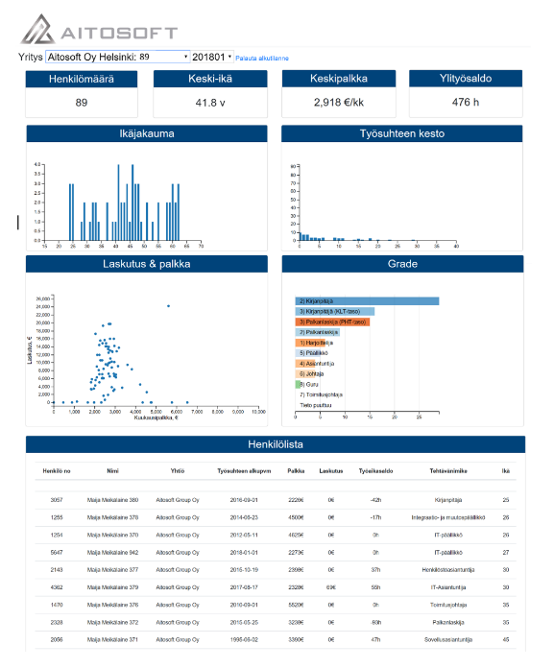
Aitosoft - Analytics visualisation platform
An extremely powerful Analytics platform for visualizing complex information. Easy to Use: No large report libraries, just a few clicks.
Platform(s): Microsoft SQL server, Azure
AI competences: Data Visualisation, Data Ingestion, Data munging
Application domain(s): Can be used in any industry
Public Reference: Tilipalvelu Rantalainen Oy
Contacts:
Name: Juha Jaakkola, CEO
E-mail: juha. jaakkola@aitosoft.com
Phone: +358 400 592 677
www.aitosoft.com

Slide 3
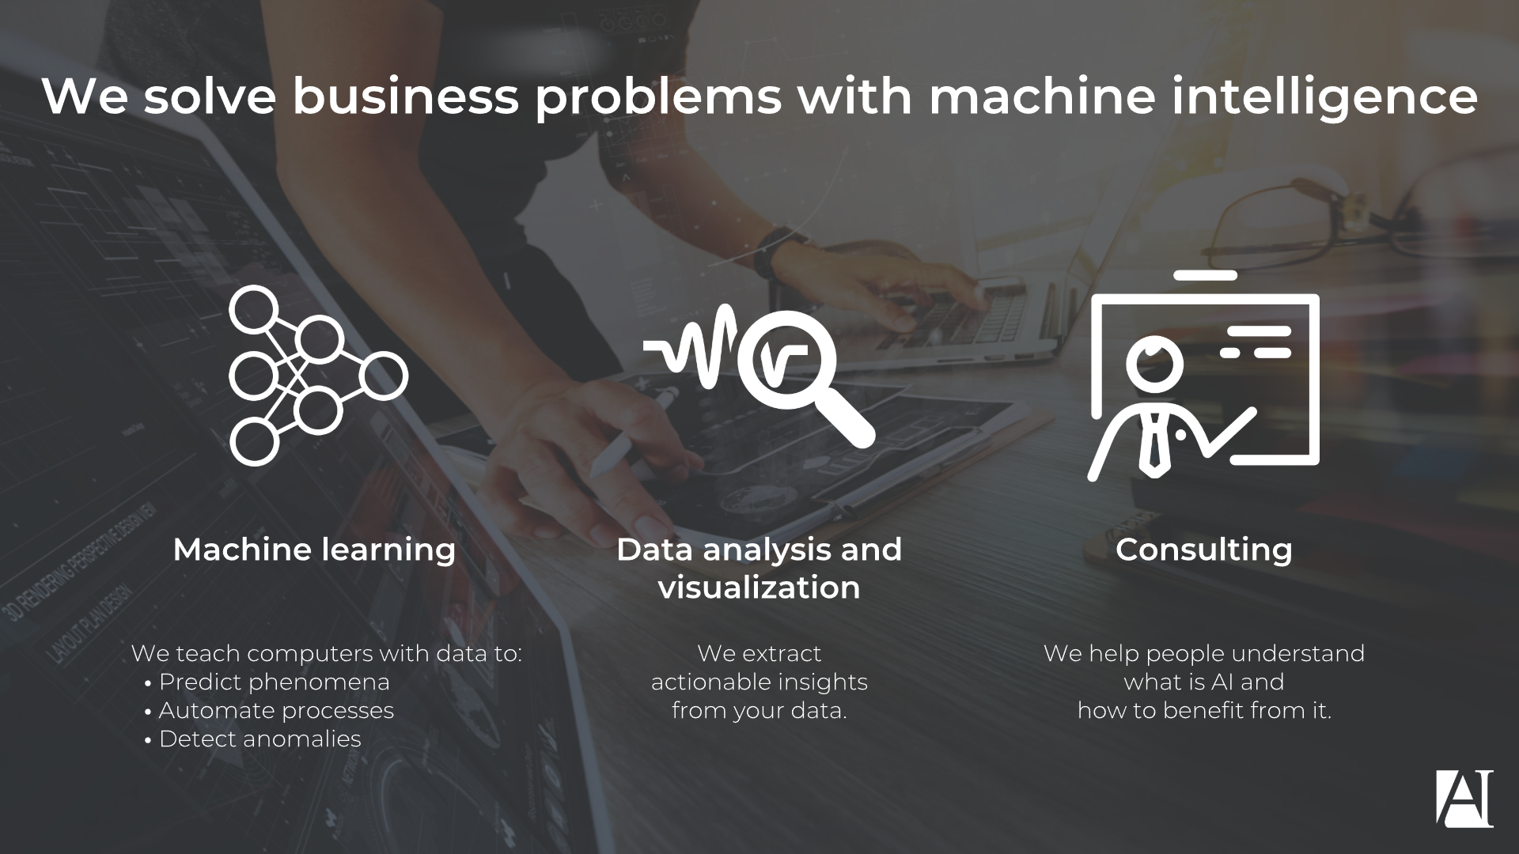
Customized Machine Learning Solutions
Artific Intelligence provides customized machine learning programming and consulting to help your business discover the power of artificial intelligence.
Platform(s): Python, R, Pandas, Scikit-learn, Keras, cloud
AI competences: Machine learning, Data visualisation
Application domain(s): Health, Science or technics, ICT, NLP
References: Cell detection from microscope images, Predictive model for nodal metastasis of breast carcinoma, Hate speech detection system for Fazer marketing campaign
Contacts:
Tuomas Tikkanen
tuomas.tikkanen@artific.ai
+358 451 555 075
Helsinki
www.artific.ai
Artific Intelligence
3

Slide 4
Avarea: Analytical Brains at Your Service
Business Advantages through Analytics.
Platform(s): Python & R ML-libraries, MS Azure, SAS Viya, AWS
AI competences: Fundamentals, Statistics, Data visualisation, Big data, Machine learning, Data wranglin & ingestion
Application domain(s): Customer, profitability and IoT analytics
References: Elisa Oyj, Helsingin Seudun Ympäristöpalvelut, Kone, Oyj, Posti Oy, ThirdPresence Oy, Valio Oy, Valmet Oyj, YIT Oyj
Contacts:
Name: Tomi Haapanen
E-mail: tomi.Haapanen@digia.com
Phone: +358 44 0233306
City: Helsinki, Finland
https://avarea.fi/

Slide 5
Software Robotics will automise the manual work between various systems
Botlabs Customer Libraries
Botlabs Robot Platform
Botlabs will provide low cost software robotics for all companies and for all domains. We will automate information flow between different information systems, ERP, invoicing etc which you currently do manually. Monthly fee, no other costs and no changes for the SW systems you currently use.
Platform(s): BotlabsRobotPlatform, RobotFramework
AI competences: RoboticProcessAutomation (RPA), Software Robots
Application domain(s): ICT
Contacts:
Name Heikki Anttila
E-mail Heikki.Anttila@botlabs.fi
Phone +358 40 5170140
City Oulu
www www.botlabs.fi
Botlabs Libraries
Robot Framework
Robot Framework Libraries
Robot programming

Slide 6
Curious AI Digital Co-Worker
Our Vison is to make Digital Co-workers. Components which understand and automate knowledge tasks. Our Document Understanding product helps Enterprises in business process optimization. Our Industrial intelligence product helps process prediction, optimisation and process control.
Platforms: Curious AI SaaS
AI competences: Machine learning, Deep Learning
Application domains: Industry(Production) , ICT, Enterprises, Auditing Firms
References: Berggren & Neste Engineering Solutions- https://www.neste.com/neste-engineering-solutions-and-curious-ai-develop-advanced-ai-technology-process-industry
Contacts:
Name - Apurva Dhawan
E-mail - sales@cai.fi
Phone - 0401427466
City - Helsinki
www.thecuriousaicompany.com

Slide 7
Sense of your data
We are your trusted digital transformation and data analytics partner. We help you to achieve business performance improvements with hands on grip – from solution architecting to implementation and maintenance
Platform(s): Power BI, R, Azure, Python
AI competences: Data architectural design, Advanced data analytics, Statistics, Programming, Machine learning, Neural Networks, Data Visualization, Block chain technologies.
Domains: Transportation, water utilities, agriculture
References: Vainion liikenne, Pohjolan matka, Salo City IoT architecture, Sitra BDE, Salo water utilities ltd.
Contact:
Jari Hakkarainen
jari.hakkarainen@datasense.fi
+358 40 5022740
Salo
www.datasense.fi

Slide 8
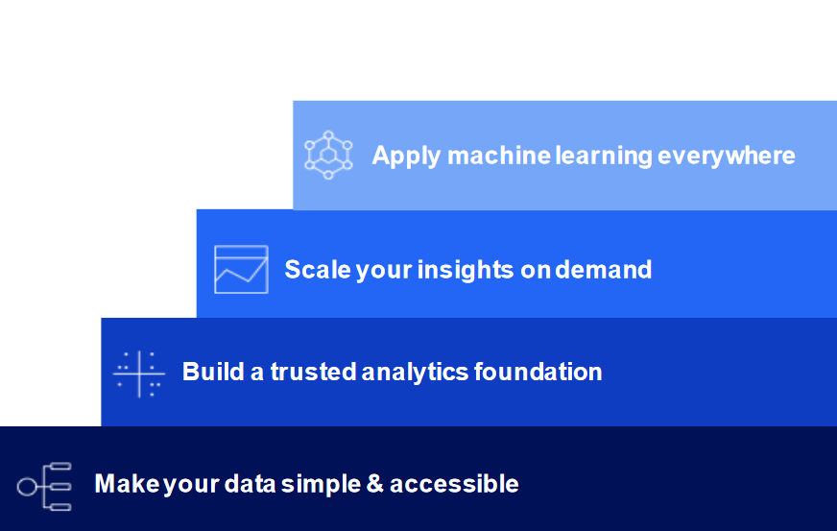
Herman IT Data Center infrastructure is optimized for high performance computing and AI platforms
IBM Cloud Private for data is the building block and foundation for centralized data storing and transforming data to be ready for enhanced analytics and AI. Technology is platform agnostic and supports multi-cloud environments. Capability to provide expertise e.g. integrations to data sources, data preparation and visualization and building dashboards.
Herman IT Private Cloud enables public cloud tools and services in a private data center with transparent and forecastable pricing. Centralized cloud management covering public clouds e.g. AWS, IBM Cloud & Azure.
Platforms: GPUs, X86, POWER9, IBM Cloud Private, IBM Cloud Private 4 Data, Containers
AI competences: AI Platforms, Data Ingestion, Data Munging, Enhanced Analytics, Machine learning
Application domain(s): Mining, Industry, Finance and Insurance, Machinery, Forest industry, ICT
References: Curious AI, Valossa and several non-public references
Contacts:
Kari Maikkola & Veli-Antti Leinonen
Kari.maikkola@hermanit.fi +358 45 636 1884
Veli-Antti.Leinonen@hermanit.fi +358 44 740 1010
Kajaani, Oulu, Helsinki
www.hermanit.fi
Tähän tuotteen /palvelun kuvituskuva

Slide 9
InnoVIBE Road Information System monitors road condition and classifies vechicles
Innofreaks builds an intelligent road infrastructure based on sensors which are placed in the road structure.
Platform(s): cloud technology
AI competences: patterns in data, Machine learning, Algorithms, optimisation
Application domain(s): Logistics, (road) construction, Sports, Wellbeing
References:
Contacts:
sales@innofreaks.fi
gsm +358 50 436 2439
Espoo
www.innofreaks.fi

Slide 10
Case: Real-time Video Stream Analysis
Picture and video identification and real-time process including fast forecasting
Platform(s): Azure, Yolo, Kalman Filter, Social LSTM
AI competences: Machine Learning, Open-source technologies
Application domain(s): ICT, several industries
References: https://www.invenco.fi/video-stream-tietomassat-analysointi/
Contacts:
Name: Petri Räsänen
E-mail: petri.rasanen@invenco.fi
Phone: +358 50 516 0525
City: Vantaa
www.invenco.fi

Slide 11
Smarten – Advanced Data Discovery tools
Just Sourcing is Nordic distributor and analytics consulting partner of Smarten Analytics Suite. We provide Smart Data Discovery tools including Augmented Analytics solution that provides sophisticated Self-Serve Tools and Guidance for the Business Users. Our easy-to-use Advanced Data Discovery Tools are suitable for all users from Business User to Data Scientist.
Platform(s): Built on Apache Spark, runs on cloud and on-premise, R integration
AI competences: ML, Big Data, Statistics, Data ingestion and visualisation
Application domain(s): ICT, multiple domains
References: Visma Public Oy
Contacts:
Name: Timo Ruotsalainen
E-mail: timo@justsourcing.com
Phone: +358 40 7501794
City: Espoo
Www: www.justsourcing.fi
Analytics plus company
11

Slide 12
Lingsoft Makes Language Digital – on Every Level De Facto Standard of Language Analysis
Lingsoft provides a wide range of services and solutions designed for the analysis, processing, production and management of spoken and written language. We help our customers understand, produce, find, create, use and edit linguistic information in a digital world filled with words.
Keywords: Accessibility, Discoverability, Productivity; Text Analytics, Speech Recognition, Machine Translation
Platform(s): IBM Watson Explorer, Microsoft Office, Adobe InDesign and InCopy, Lingsoft LMC3.0 (API’s available)
AI competences: Machine learning, Text mining, NLP, Big Data
Application domain(s): ICT, Finance and insurance, Science or technics, Management and support, Public, Education, Health, Media (and more)
References: IBM, Microsoft, VRK/Suomi.fi, YLE, VSSHP / Auria Palvelut, SYNLAB
Contacts:
Maria Leinonen, Chief Digital Experience Officer
E-mail: maria.leinonen@lingsoft.fi
Phone: +358 40 5465 717
City: Turku, Finland
www.lingsoft.fi

Slide 13
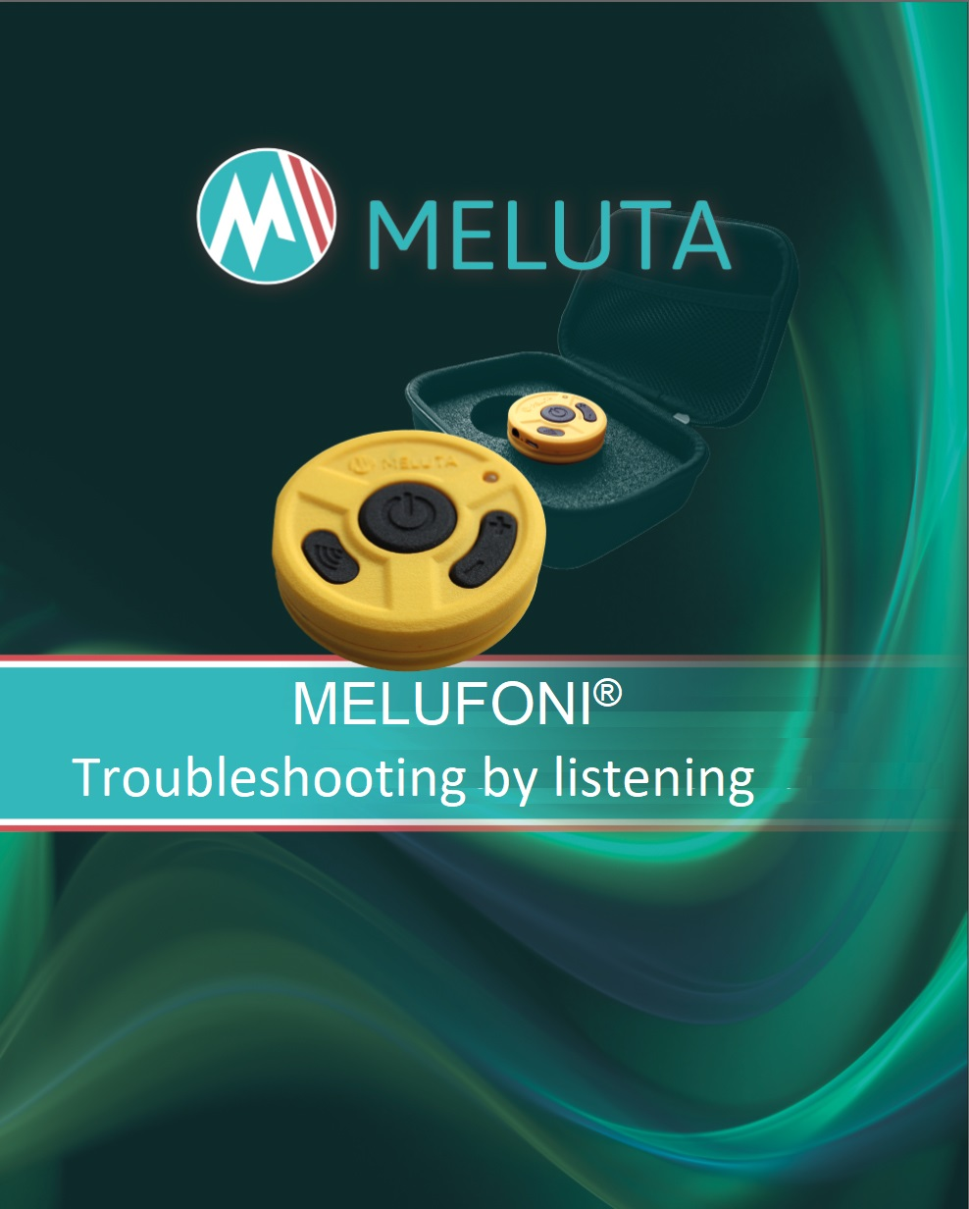
Acoustic and vibroacoustic applications and sensor solutions for IIOT customers
Melufoni ® wireless stethoscope – a product example of embedded electronics, radio technology and energy efficient systems - is an excellent tool for fault detection and condition monitoring.
Platform(s): Windows/Linux, embedded, MatLab, Python, Java, C++
AI competences: Fundamentals, programming, machine learning, visualization and toolboxes
Application domain(s): Science of technics, Industry
References: e.g.
Contacts:
Markku Salmela
Markku.Salmela@meluta.fi
+358 50 5247438
Hermiankatu 12E, Tampere, Finland
www.meluta.fi

Slide 14
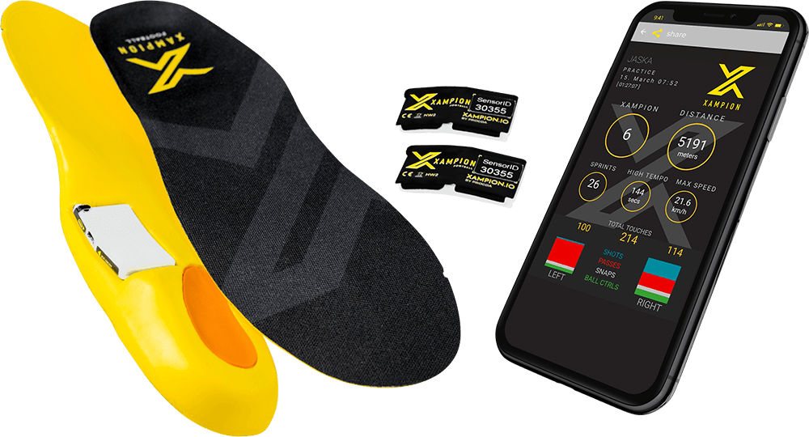
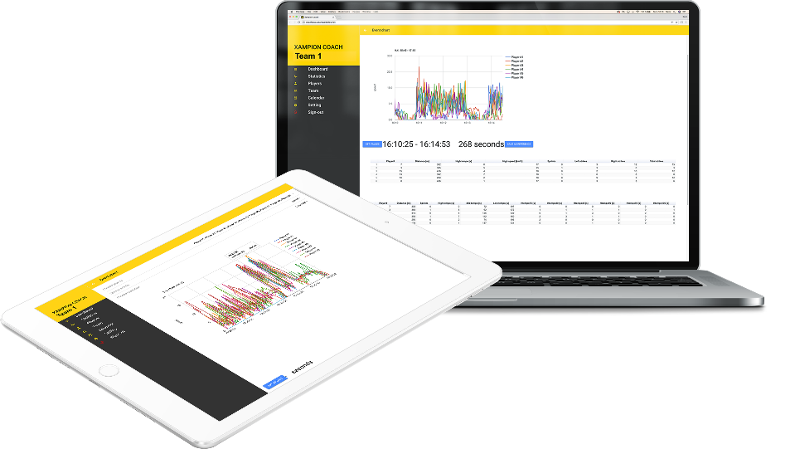
Multi-purpose motion detection and data analytics for fact-based decision making
Progda has built a platform for modelling and analysing motion tracked by wearable sensors. The technology can be used to analyse movement in sports, health care, manufacturing and numerous other environments. The first product application built with this technology is the Xampion Football Tracking System.
Platforms: HW, Firmware, C and MS.NET
AI competences: Statistics, Programming, Data visualisation, Big Data, Data ingestion, data munging
Application domains: Science or technics / Other services
References: Xampion® Football Tracking System (xampion.com)
Contacts:
Name: Mr. Tero Suominen, CEO
Email: tero.suominen@progda.com
Phone: +358 50 482 0827
City: Kaarina, Finland
www: progda.com / xampion.com

Slide 15
Quva® Flow – AI enhanced process quality monitoring for keeping things in control
Easy-to-use automated analytics and visualizations with innovative tacit knowledge integration
Platform(s): Open source
AI competences: Statistics, Programming, Machine learning, Data visualisation, Big data
Application domain(s): Industry (production)
References: UPM, Stora Enso, Mondi, BillerudKorsnäs, SSAB, Outokumpu, Mirka, Teknos, Tikkurila, Aurubis, etc.
Contacts:
Name Emil Ackerman
E-mail emil.ackerman@quva.fi
Phone +358 45 2086 816
City Tampere
www www.quva.fi/en

Slide 16
Private AI lab building AI for people as a service
Our team of 20 PhDs create cutting edge technology and Machine learning, Computer Vision and Natural Language Processing solutions for faster data processing, quick iterations, simple proof-of-concepts and easy deployment with continuous learning and Human-in-the-loop approach.
Platform: Platform/Ecosystem agnostic
AI competences: Machine Learning, NLP, Computer Vision
Application domains: Central banks, Retail and consumer services, Private financial institutions, Recruitment & HR, Advertising & Media, Infrastructure & Energy, Legal industry, Production & Manufacturing, Airlines and Maritime.
References: Undisclosed
Contact:
Ville Hulkko, CCO, ville@silo.ai, +35840 7700010
Helsinki, Finland
https://silo.ai

Slide 17
Machine Learning and Computer Vision in Industrial Setting
SSF provides machine learning and computer vision development:
Platform(s): TensorFlow, Keras, Python ecosystem
AI competences: Machine learning, computer vision, programming (especially embedded)
Application domain(s): Industry
References: SSF has references from production, medical devices and aerospace industry. Contact for further details.
Contacts:
Jaakko Hujanen
jaakko.hujanen@ssf.fi
+358 50 3848842
Espoo
www.ssf.fi
Analytics plus company

Slide 18
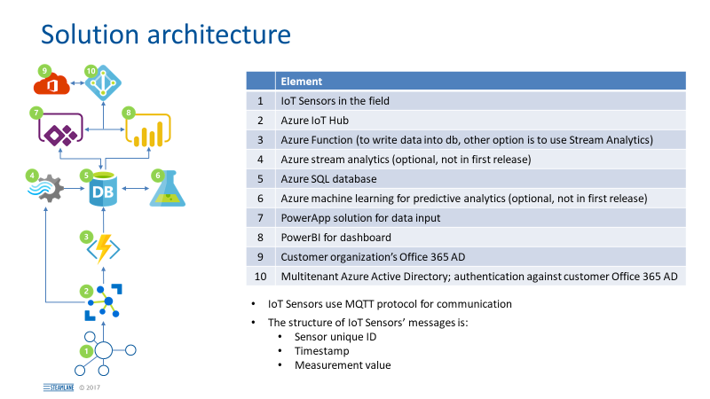
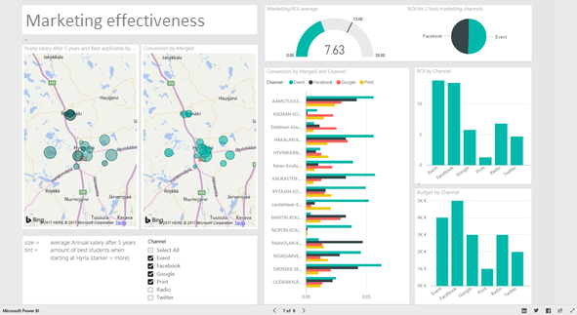
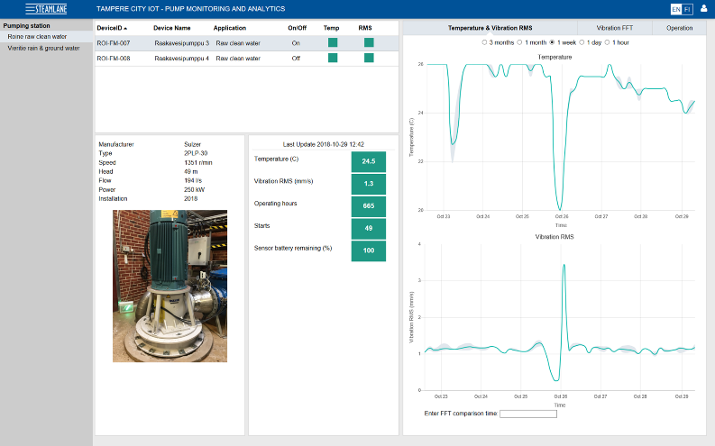
Steamlane data analytics and cloud solutions for IoT and digitalization projects
We help customers to utilize data for improving their business
Platform(s): Microsoft Azure and open source key libraries
AI competences: Fundamentals, Statistics, Programming, Machine learning, Text mining and NLP, Data visualisation, Big data, Data ingestion
Application domain(s): Industry, Energy, Water and waste, Logistics, ICT, Management and support, Public, Education
References: Several private and public sector customers
Contacts:
Ari Karppinen
ari.t.karppinen@steamlane.com
+358 50 5410775
Tampere
www.steamlane.com

Slide 19
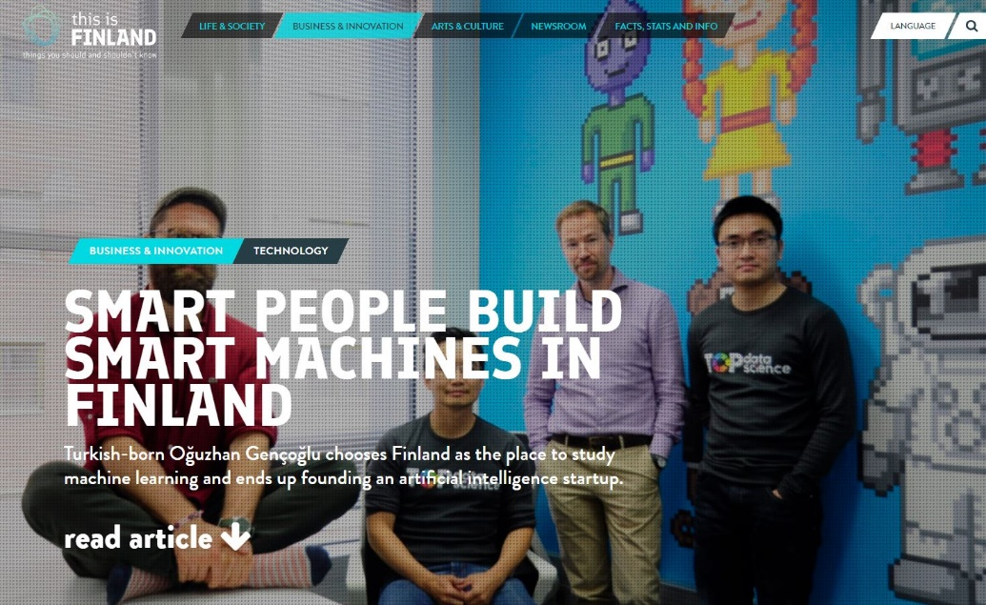
Advanced analytics and computer vision solutions powered by AI.
Top Data Science is a Finnish data science company focusing on AI powered Computer Vision and Deep Learning solutions, technologies and development services. The company is working and partnering with several corporate customers in technology, healthcare and IIoT.
Platform(s): Our solutions are based on major open-source technologies, Python.
AI competences: Deep learning, Machine Learning, Computer Vision
Application domain(s):
Industry (production)
Health
References: Morpho Inc., GE, Stora Enso, Optofidelity, HUS Hospital, Global Biotechnology Company (Undisclosed).
Contacts:
Timo Heikkinen, CEO & Cofounder +358405894400 timo.heikkinen@topdatascience.com Top Data Science Ltd. Kuortaneenkatu 2 FI-00510 Helsinki FINLAND http://topdatascience.com/

Slide 20
Valossa AI – the leading video recognition and content intelligence platform
Valossa AI use cases: content compliance and safety, real-time monitoring, content search and management.
Platform(s):
AI competences: Toolbox, pattern recognition, machine learning
Application domain(s): ICT, arts, media
References:
Contacts:
Mika Rautiainen / Sami Niska
mika@valossa.com / mika.Niska@valossa.com
+358 400 122586 / +358 50 4876582
Oulu
www.valossa.com
Tähän tuotteen /palvelun kuvituskuva
Tähän yrityksen logo

Slide 21
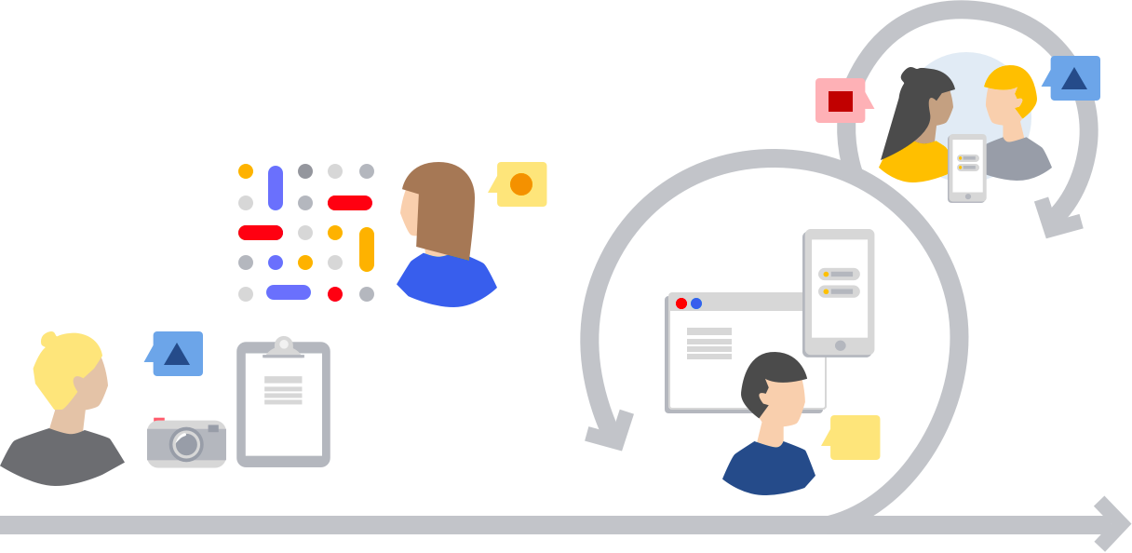
Varis includes text data sets to your analysis
Varis acts as a mediator between the inherently heterogeneous and complex world of texts and a more rigid data model.
Platforms: as needed, native Python API, Docker deployment
AI competences: programming, NLP, machine learning, data ingestion
Application domains: ICT, Industry, Energy, Finance and insurance, Sales, Science or technics, Health, other services
References: Otavamedia, Laurea
Contacts:
Name Marko Laakso
E-mail marko.laakso@valuemotive.com
Phone +358 45 135 4248
City Helsinki
WWW https://varis.ai
Analytics plus company
21

Slide 22
Contact information
Leila Saari leila.saari@vtt.fi
+358 408208929
https://www.analytics.plus/

